Slide 1

MOVIE SUGGESTION
CSC 580 ADVANCED PYTHON PROGRAMING
CA2- PROJECT
Done By:
Maria Anthony Raja (E7321009)
Course Faculty:
Prof.Nirmala.B

Slide 2
CONTENT
Introduction
Objective
Introduce the dataset
Highlights from EDA (Visualization)
Final model
Interesting findings from the model
Conclusions
Future work

Slide 3

INTRODUCTION
From Top 1000 IMDB Movies Dataset - Analyse the relationship between each columns.
And create the movie suggestion model using Machine Learning Algorithms.

Slide 4
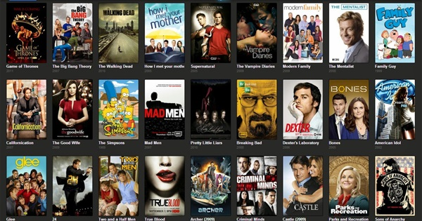
Objective
Problem Statement – From user’s searched movie as an input.
The model will suggest some movies that related to the user searched movie.
K Means Algorithm is used to create the Model.

Slide 5
Introduce the Dataset
Poster_Link - Link of the poster that imdb using - Object
Series_Title = Name of the movie - Object
Released_Year - Year at which that movie released - Numeric
Certificate - Certificate earned by that movie - Object
Runtime - Total runtime of the movie - Object
Genre - Genre of the movie - Object
IMDB_Rating - Rating of the movie at IMDB site - Numeric
Overview - mini story/ summary - Object
Meta_score - Score earned by the movie - Numeric
Director - Name of the Director - Object
Star1,Star2,Star3,Star4 - Name of the Stars - Object
No of votes - Total number of votes - Numeric
Gross - Money earned by that movie – Object
Total Rows : 1000

Slide 6
EDA (Visualization)
Data Pre-processing:
Explore the Statistical & Basic information of data.
Check whether NAN values are there in dataset.
If NAN presented – fill those NAN – Certificate , Meta score , Gross
Convert the columns into appropriate datatypes – Genre (Action, Crime, Drama) , Runtime (152 min ) , Director (Christopher Nolan ) , Certificate (A).
Drop unnecessary columns - Star1,Star2,Star3,Star4, Poster_Link , Series_Title , Overview , Genre.
Standardization :
No of votes : Min - 2.508800e+04 - Max - 2.343110e+06
Gross : Min - 1.305000e+03 - Max - 9.366622e+08

Slide 7
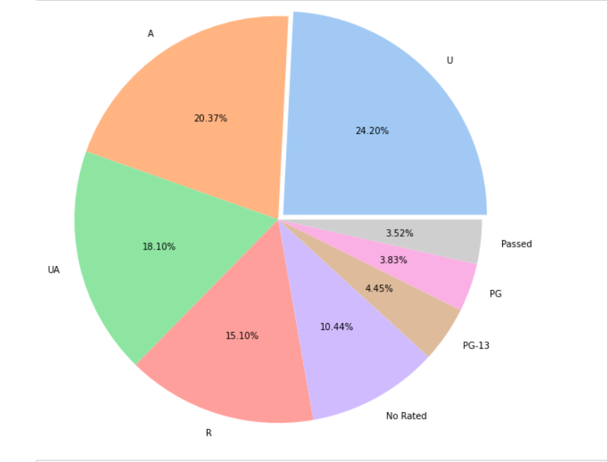
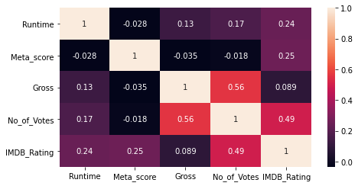
Data Visualization:

Slide 8
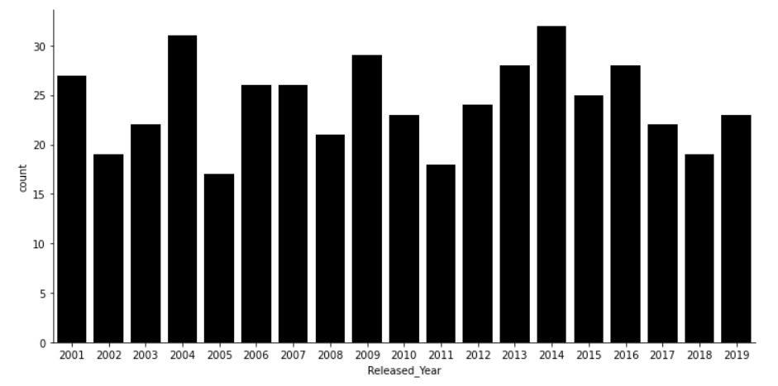
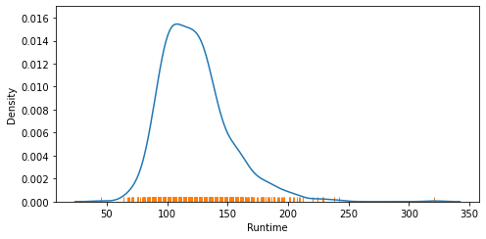
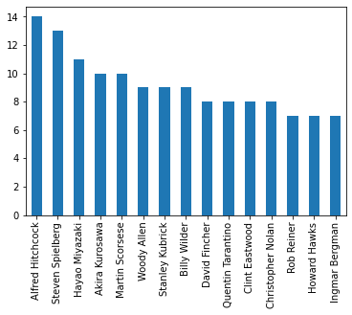
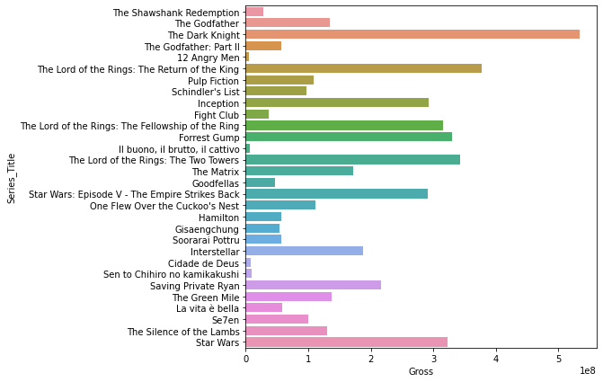

Slide 9
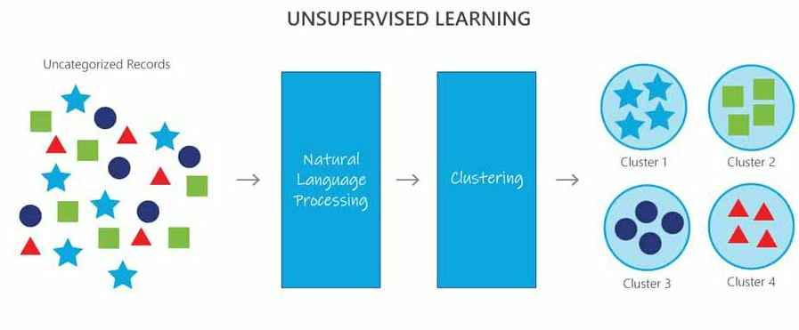
Final Model
K-means clustering is a simple unsupervised learning algorithm that is used to solve clustering problems.
K = 40 , Hence 40 clusters are created in the model.
Class Label is now created using cluster labels.

Slide 10
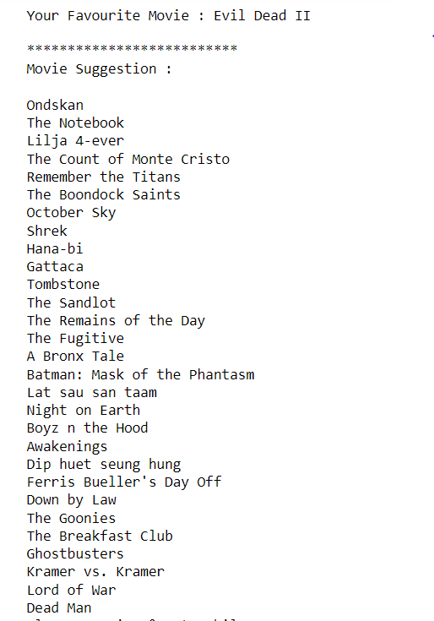
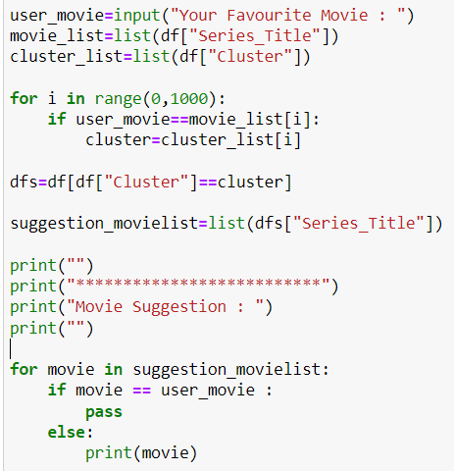
Interesting findings from Model:

Slide 11
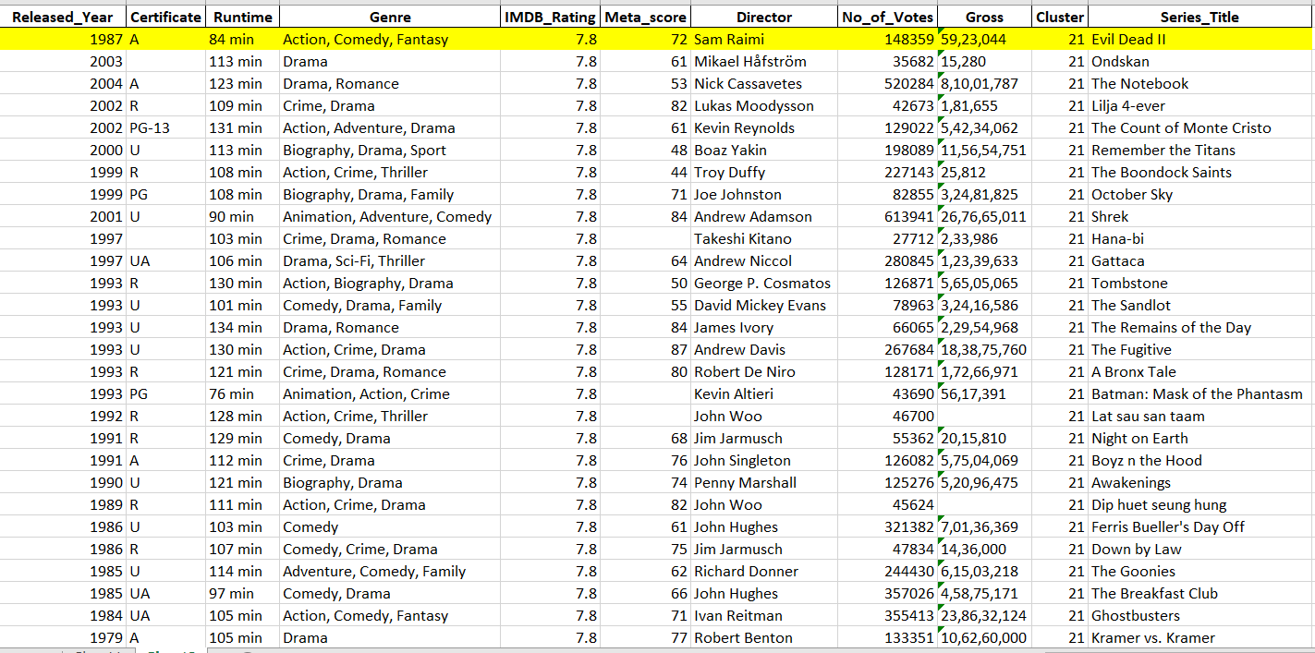
Conclusion:

Slide 12
Future Work :
This dataset contains only 1000 movies.
Directors and Actors columns are not effective. Since it have many unique values.
When the dataset increase , the suggestion will be more useful.

Slide 13
Thank you

